Slide 1
Economic influence on workplace closure during the pandemic
Shuheng Jiang & Tianrun Zhu

Slide 2
Background
COVID-19 has profoundly transformed global daily life through the enforcement of mandatory or recommended isolation measures. As nations adopt varied policies and strategies to combat the virus's spread, numerous studies have explored how political, cultural, and economic factors shape the stringency of COVID-19 policy responses (Frey et al., 2020; Tang et al., 2022).
Amid the pandemic, administrators must balance the need for workplace closures to control infection rates with the potential impact on economic development.
Our research specifically focuses on the influence of economic factors on the closure policy responses, examining how economic considerations guide decisions in the midst of health crises.

Slide 3
Data Overview
In total we have 9 variables:
We derived 6 variables about economics: export and import volume by country, Industrial Sector's Contribution to GDP (range: 0-100, higher value means higher proportion of the sector’s contribution to GDP), agricultural sector’s contribution to GDP (range: 0-100), manufactural sector’s contribution to GDP (range: 0-100) and service sector’s contribution to GDP (range：0-100）by country
two variables to calculate infectious rate: population by country and cumulative case of infection by country (infectious rate = cumulative case / population)
workplace closure level during the pandemic by country (range：32-1715， higher value means more strict workplace closure policy)
Timespan: 2020
Countries: 145 countries in total, we include countries that varies in GDP, policy strictness, as well as infectious rate.

Slide 4
Research Questions
Is the effect of infectious rate on closure moderated by the industrial sector's share of GDP?
Rationale: Countries with a significant portion of their GDP derived from industry may experience more severe economic repercussions from workplace closures. This can lead to a more cautious approach to imposing such restrictions, balancing health risks against economic stability.
Furthermore, is the effect of infectious rate on closure moderated by other economic sectors’ share of GDP in a way different than industry?
Rationale: Industrial and manufacturing jobs often require physical presence than other economic sectors. To further validate the moderation effect for industry, economic sectors other than industry can be tested.
Does industrial sector's share of GDP interact with export volume to have effects on policy making regarding workplace closure?
Rationale: To further explore the interaction between different economic factors. International trade inherently involves a level of human contact.

Slide 5
Research Question 1:
Is the effect of infectious rate on closure moderated by the the industrial sector's share of GDP?
Hypotheses: for countries with lower industry sector’s share of GDP, higher infectious rate predicts higher closure policy; for countries with higher industry sector’s share of GDP, effect of infectious rate on closure is less significant
model:
closure = b0 + b1* infectious rate + b2*industry+ b3*industry*infectious rate

Slide 6
Data Analysis: Testing Linear Model Assumption
For our predictor “industry”, we group the continuous values into categories, with “High” group including the countries that has industry share value larger than 1 standard deviation above the mean; “Low” group including observations that has industry share smaller than 1 standard deviation below the mean; “Midium” group includes countries with industry value in between “High” and “Low” groups.
We test the data in these three groups separately against the three GLM assumptions:
Normality of residuals
Constant variance (homoscedasticity)
Linearity of relationships

Slide 7
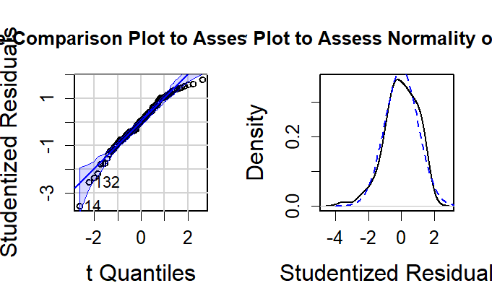
Here is our result of testing data against model assumptions(“Medium” group only):

Slide 8
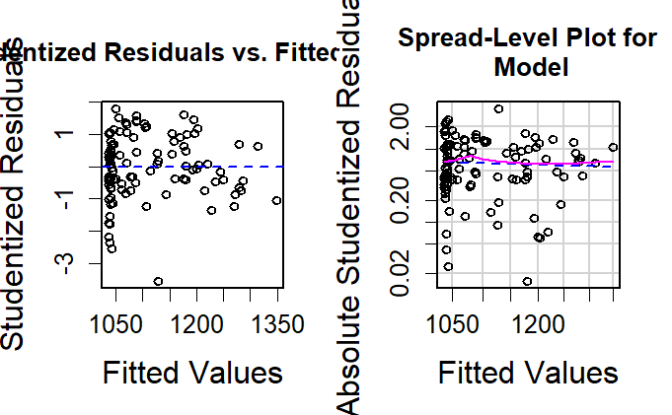
heteroscedasticity

Slide 9
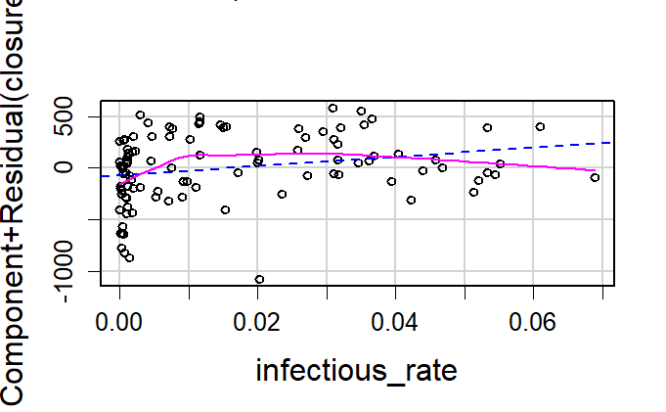

Slide 10
Data Transfromation
Large range
large portion of points in the lower tail
d$infectious_rate_t <- d$infectious_rate^.5
refit the model:
closure = b0 + b1 * infectious rate ^ 0.5 + b2 * industry + b3 * industry * infectious rate

Slide 11
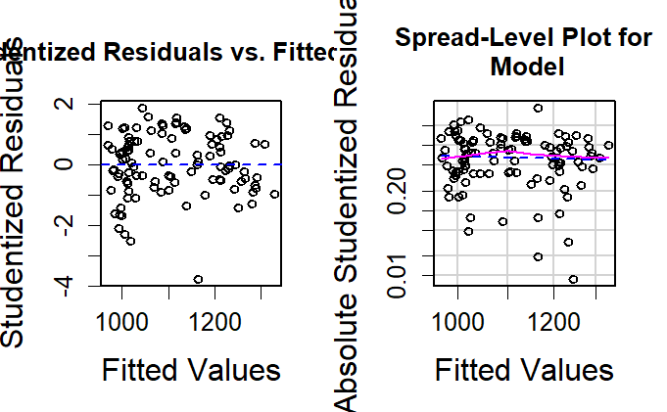
Issue solved

Slide 12
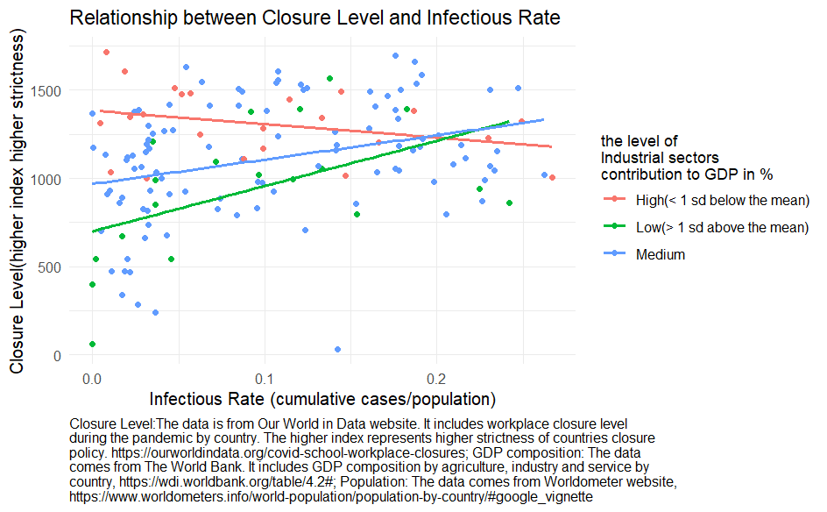
Results

Slide 13
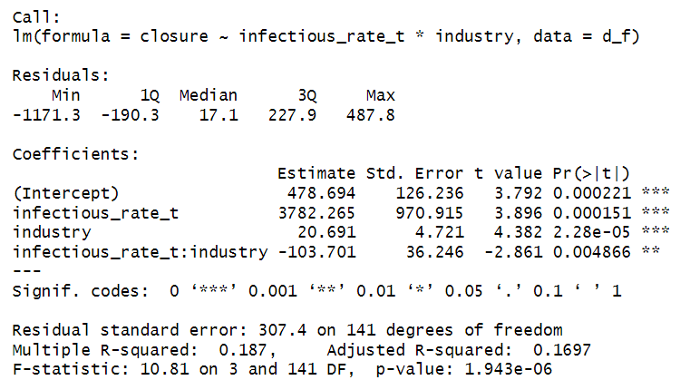

Slide 14
Results
In order to test hypotheses, we estimated a regression model in which we regressed closure on industry, square root of infectious rate and their interaction.
As predicted, there was a statistically significant interaction, F(1, 144) = 8.19, p = 0.005, eta_squared = 0.05. For every one unit increase in square root infectious rate, the simple effect of industry decreases by 103.7 unit on closure score

Slide 15
Hypothesis: for countries with lower industry sector’s share of GDP, higher infectious rate predicts higher closure policy; for countries with higher industry sector’s share of GDP, effect of infectious rate on closure is less significant
Our hypothesis is confirmed. Countries that rely heavily on industrial output for a large part of their economic activity might face greater economic challenges due to the closure of workplaces. To preserve their economic stability, these countries might be more hesitant to shut down workplaces.

Slide 16
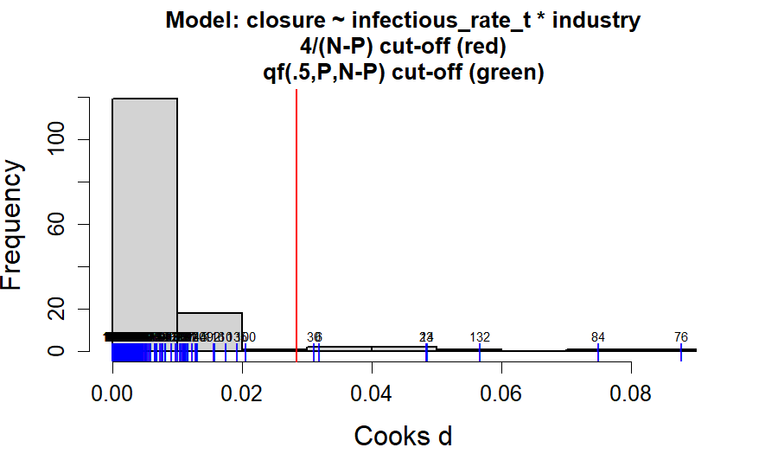
Discussion
whether to exclude high influence points:
84: Luxembourg(closure: 861, industry: 11.3(Low), infectious rate: 0.242)
76: Kiribati (closure: 63, industry: 10(Low), infectious rate: 0

Slide 17
Research Question 2:
Is the effect of infectious rate on closure moderated by other economic sectors’ share of GDP in a way different than industry?
Hypotheses:
In the realm of industrial sub-sectors, manufacturing exhibits a parallel moderating impact comparable to that of the broader industry sector, in mitigating the effects of infection rates on workplace closures.
Conversely, the agricultural and service sectors do not demonstrate a similar attenuating influence on the correlation between infection rates and the implementation of workplace closures.

Slide 18
Research Question 2(Cont.)
model:
closure = b0 + b1* infectious rate^0.5 + b2 * industry + b3 * industry * infectious rate
closure = b0 + b1* infectious rate^0.5 + b2 * manufaturing+ b3 * manufaturing * infectious rate
closure = b0 + b1* infectious rate^0.5 + b2 * agriculture+ b3 * agriculture *infectious rate
closure = b0 + b1* infectious rate^0.5 + b2 * services + b3 * services * infectious rate
as before, to meet the model assumptions of our GLM, we do the transformation for our predictor infectious rate

Slide 19
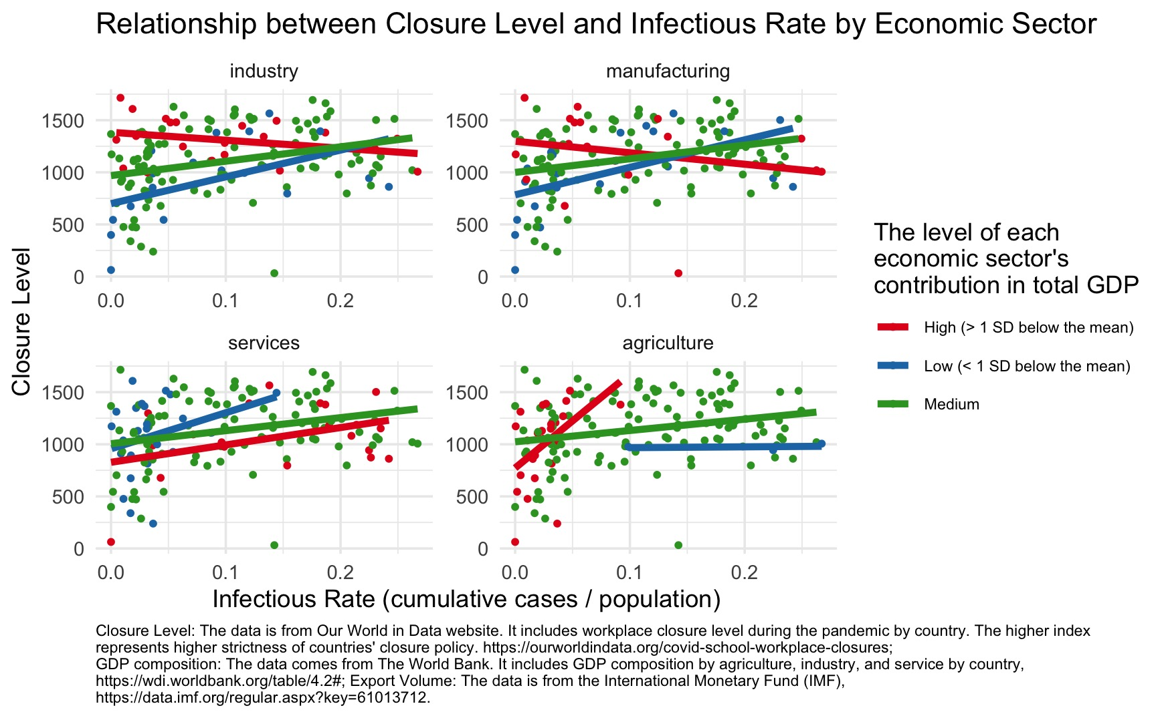
Results

Slide 20
Results
As predicted, there was a statistically significant interaction between infectious rate and manufacturing share in GDP, F(1, 144) = 12.36, p < 0.001, eta_squared =0.08. For every one unit increase in square root infectious rate, the simple effect of manufacturing decreases by 183.7 unit on closure score, it shows a convergent validity with model prediction for industry.
There was no statistically significant interaction between infectious rate and service share in GDP, F(1, 144) = 0.281, p = 0.597, eta_squared < 0.001.
There was a statistically significant interaction between infectious rate and agriculture share in GDP, F(1, 144) =19.84, p < 0.001, eta_squared = 0.12, the pattern of interaction is totally different from that of the manufacturing model and industry model, for every one unit increase in square root infectious rate, the simple effect of agriculture increases by 294.68 unit on closure score.

Slide 21
Hypotheses: In the realm of industrial sub-sectors, manufacturing exhibits a parallel moderating impact comparable to that of the broader industry sector, in mitigating the effects of infection rates on workplace closures. Conversely, the agricultural and service sectors do not demonstrate a similar attenuating influence on the correlation between infection rates and the implementation of workplace closures.
The hypothesis is confirmed. Agriculture and services may not be as severely influenced by workplace closure as industry. Service-based economies might have greater flexibility to adapt to closures, as more jobs in this sector can transition to remote work. This can influence the extent and stringency of workplace closure policies.
Higher portion of agriculture in GDP may correlates with lower involvement in the global market.
The operation of agriculture varies greatly from country to country. In some countries, agriculture is based on small-scale family units, while in others, it is dominated by mechanized farming. This is influenced by a variety of factors including geography, economy, culture, and technology. Therefore, when agriculture is analyzed as a whole, the reference value is not significant.

Slide 22
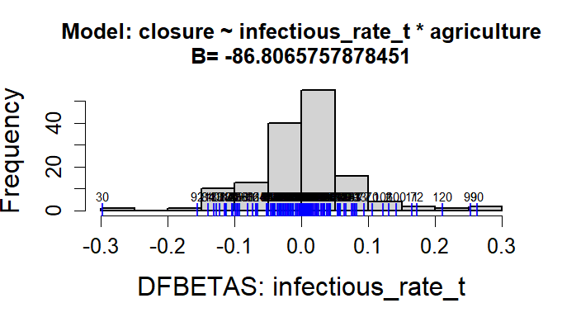
Discussion
For model in agriculture, we have a slope for predictor infectious rate being -86.807, which is contrary to the norms. We want to investigate whether there are any outliers affect the slope or any hidden comfound?
outlier:
China: agriculture:7.7; infectious rate:6.780876e-05; closure: 1715
this observation has the extremely low infectious rate but extremely high closure

Slide 23
Research Question 3:
Does industrial sector's share of GDP interact with export volume to have effects on policy making regarding workplace closure?
Hypothesis: for countries with lower industry sector’s share of GDP, higher export volume predicts higher closure policy; for countries with higher industry sector’s share of GDP, effect of export volume on closure is less significant
model:
closure = b0 + b1* industry + b2 * export + b3 * industry * export

Slide 24
Data Analysis: Testing Linear Model Assumption
For our predictor “industry”, we group the continuous values into categories, with “High” group including the countries that has industry share value larger than 1 sd above the mean; “Low” group including observations that has industry share smaller than 1 sd below the mean; “Midium” group includes countries with industry value in between “High” and “Low” groups.
We test the data in these three groups separately against the three GLM assumptions:
Normality of residuals
Constant variance (homoscedasticity)
Linearity of relationships

Slide 25
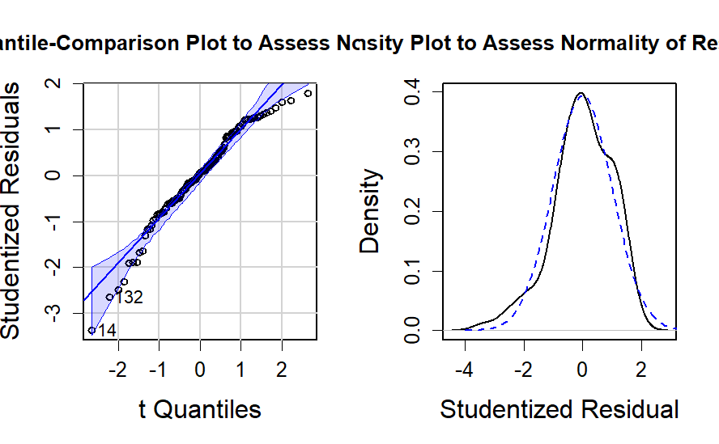
Here is our result of testing data against model assumptions(“Medium” group only):

Slide 26
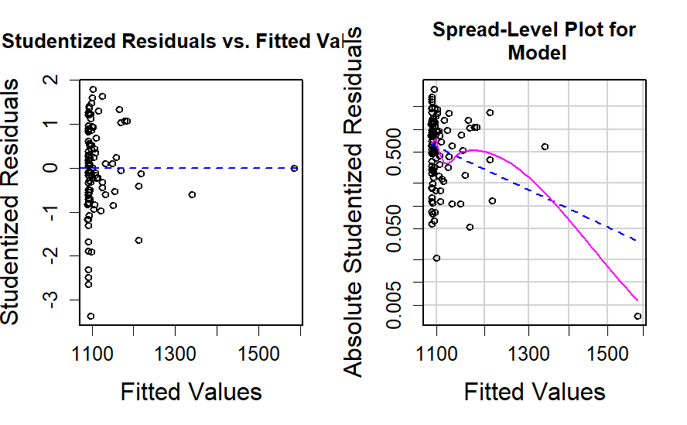
heteroscedasticity

Slide 27
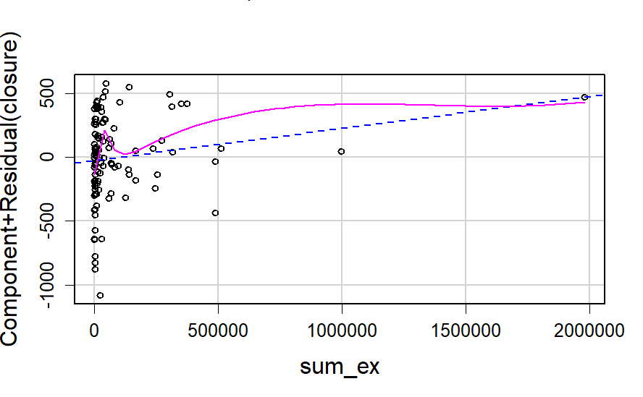
non-linear

Slide 28
Data Transfromation
Large range
large portion of points in the lower tail
non-linear
df$sum_ex_log <- log(df$sum_ex + 1)
refit the model:
closure = b0 + b1 * industry + b2 * log(Export Volume + 1) + b3 * industry * log(Export Volume + 1)

Slide 29
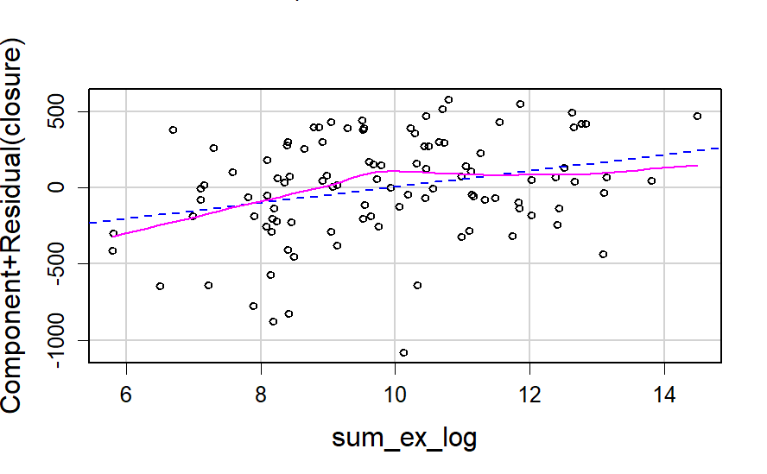
issue solved

Slide 30
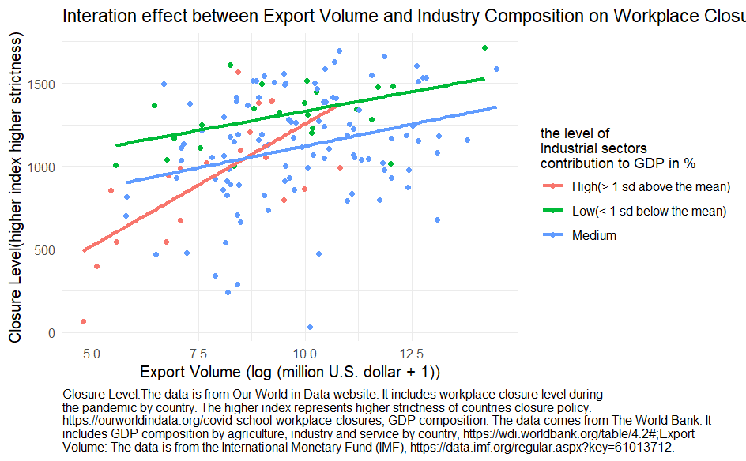
Results

Slide 31
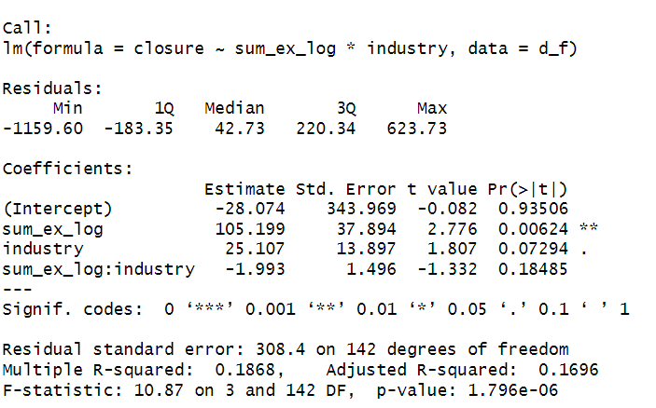
Results

Slide 32
Results
In order to test hypotheses, we estimated a regression model in which we regressed closure on industry, log(Export Volume +1) and their interaction.
There was no statistically significant interaction between closure and Export Volume in GDP, F(1, 144) = 1.774, p = 0.185, eta_squared = 0.001.
There is a positive relationship between export volume and workplace closure, F(1, 144) = 7.706, p = 0.01, eta_squared = 0.02

Slide 33
Hypothesis: for countries with lower industry sector’s share of GDP, higher export volume predicts higher closure policy; for countries with higher industry sector’s share of GDP, effect of export volume on closure is less significant
The hypothesis is not supported. There is no significant interaction between industry sector’s share of GDP and export volume.
The positive relationship between export volume and workplace closure may be as a result of the relationship between export volume and infectious rate, as international trade inherently involves a level of human contact. The more the export volume, the more the country is involved in international trade, thus higher potential for infection.

Slide 34
Limitations
Potential confounds can influence the moderation effect. For example political and cultural factors, such as individualism, as mentioned in Frey et al., (2020) can affect policy making.
We merged 5 datasets to conduct the analysis. Some countries do not have values in all datasets which may introduce potential variance to the statistical models.
The implementation intensity of the policy may not match the originally envisaged policy intensity. For example, some organizations may have higher autonomy and will not close the workplace as required by the policy.
The export and import data adapted from IMF does not include the data for May and June 2020.

Slide 35
Future Direction
In our exploration of various models, we observed that Health Policy is likely influenced by the intricate interplay of economic, political, and cultural factors. Future research could benefit from incorporating cultural and political elements, either as focal predictors or as covariates, to yield more precise and comprehensive results.
Longitudinal studies can be conducted to investigate the factors influencing health policy making over time.

Slide 36
Datasets
Workplace Closure: The data is from Our World in Data website. It includes workplace closure level during the pandemic by country. The index represents countries’ response level of strictness.(source from: https://ourworldindata.org/covid-school-workplace-closures)
International trade: The data Exports_and_Imports_by_Areas_and_Co comes from the International Monetary Fund (IMF). It includes export and import volumes by country from 2014 to 2022. (source from: https://data.imf.org/regular.aspx?key=61013712)
GDP composition: The data comes from The World Bank. It includes GDP composition by agriculture, industry and service by country. (source from: https://wdi.worldbank.org/table/4.2#)
Population: The data comes from Worldometer website. The raw data includes variables such as population, urban percentage and land area by country. (source from: https://www.worldometers.info/world-population/population-by-country/#google_vignette)
Cumulative cases of infection: The data comes from World Health Organization (WHO). It includes cumulative cases of infection from 2019 to 2023. (source from: https://covid19.who.int/data)

Slide 37
References
Frey, C. B., Chen, C., & Presidente, G. (2020). Democracy, culture, and contagion: Political regimes and countries responsiveness to Covid-19. Covid Economics, (18).
Tang, J. W., Caniza, M. A., Dinn, M., Dwyer, D. E., Heraud, J. M., Jennings, L. C., ... & Zaidi, S. K. (2022). An exploration of the political, social, economic and cultural factors affecting how different global regions initially reacted to the COVID-19 pandemic. Interface Focus, 12(2), 20210079.

Slide 38
Questions?

Slide 39
Thank you!

